Slide 1
Lecture 26: Resource issues on a finite Earth
Sound should accompany this presentation.
If you’re not hearing a voice-over in “play” mode,
make sure the volume is turned up on the speakers
of your device. If all else fails, there should be text
in a part of your screen below this window.
Notes:
1. Hi everybody, and welcome to this brief lecture about resources and the rate at which we have used them. Talking about rates means we’re talking about time, which takes us to thinking about the very great age of the Earth.

Slide 2
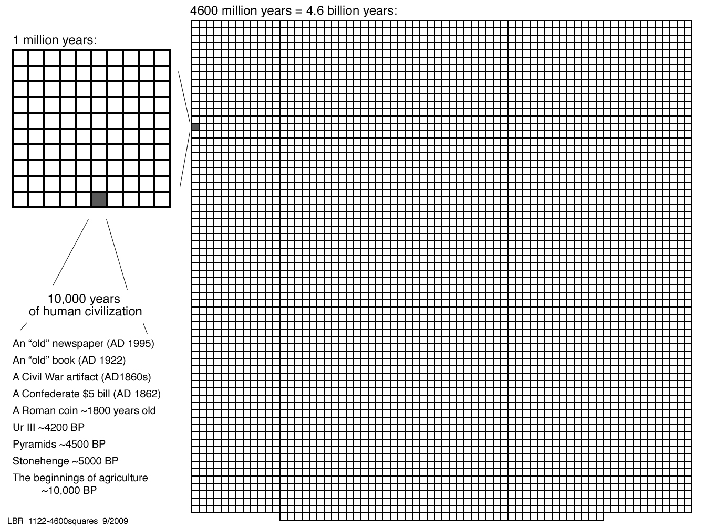
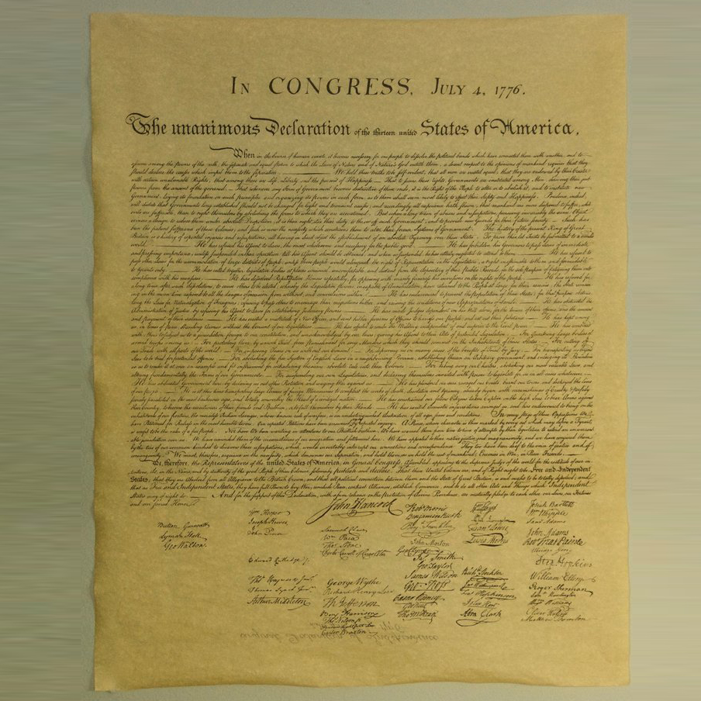
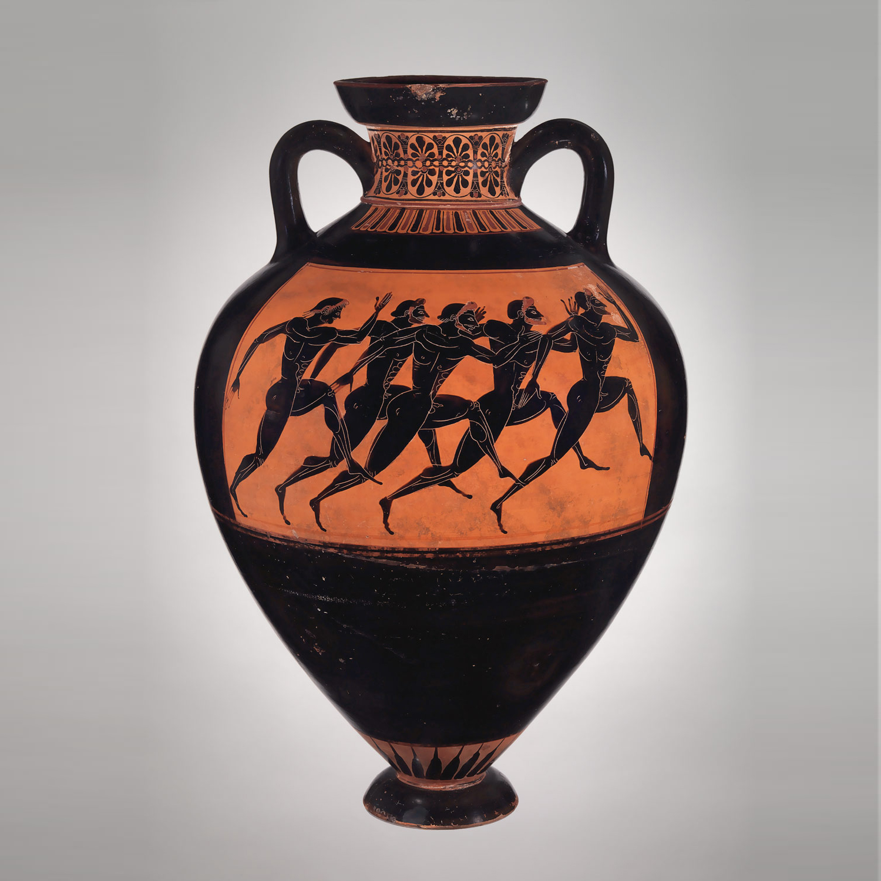
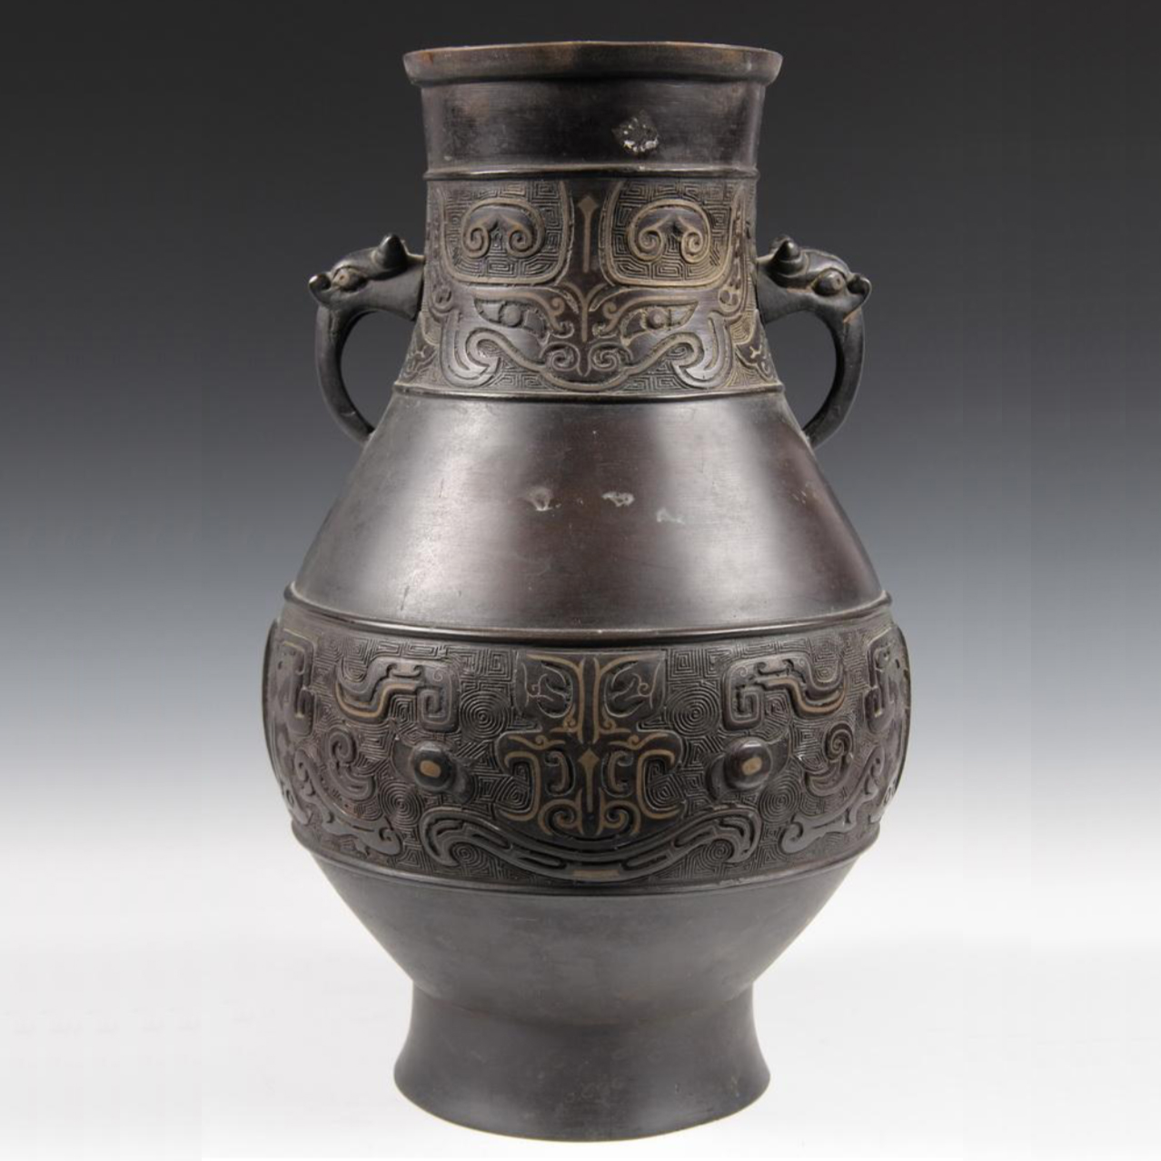
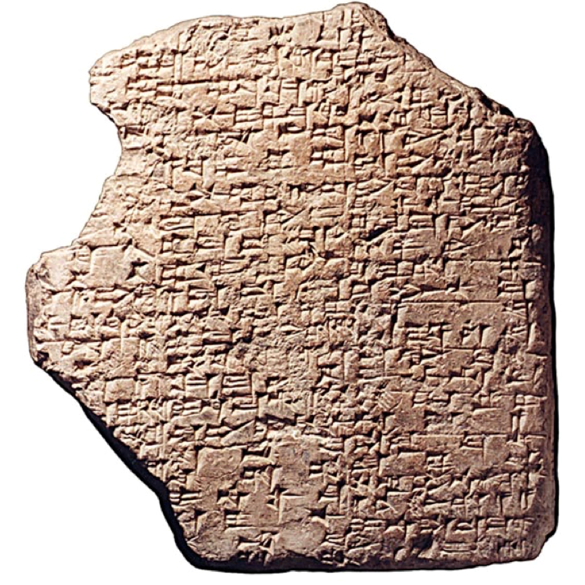
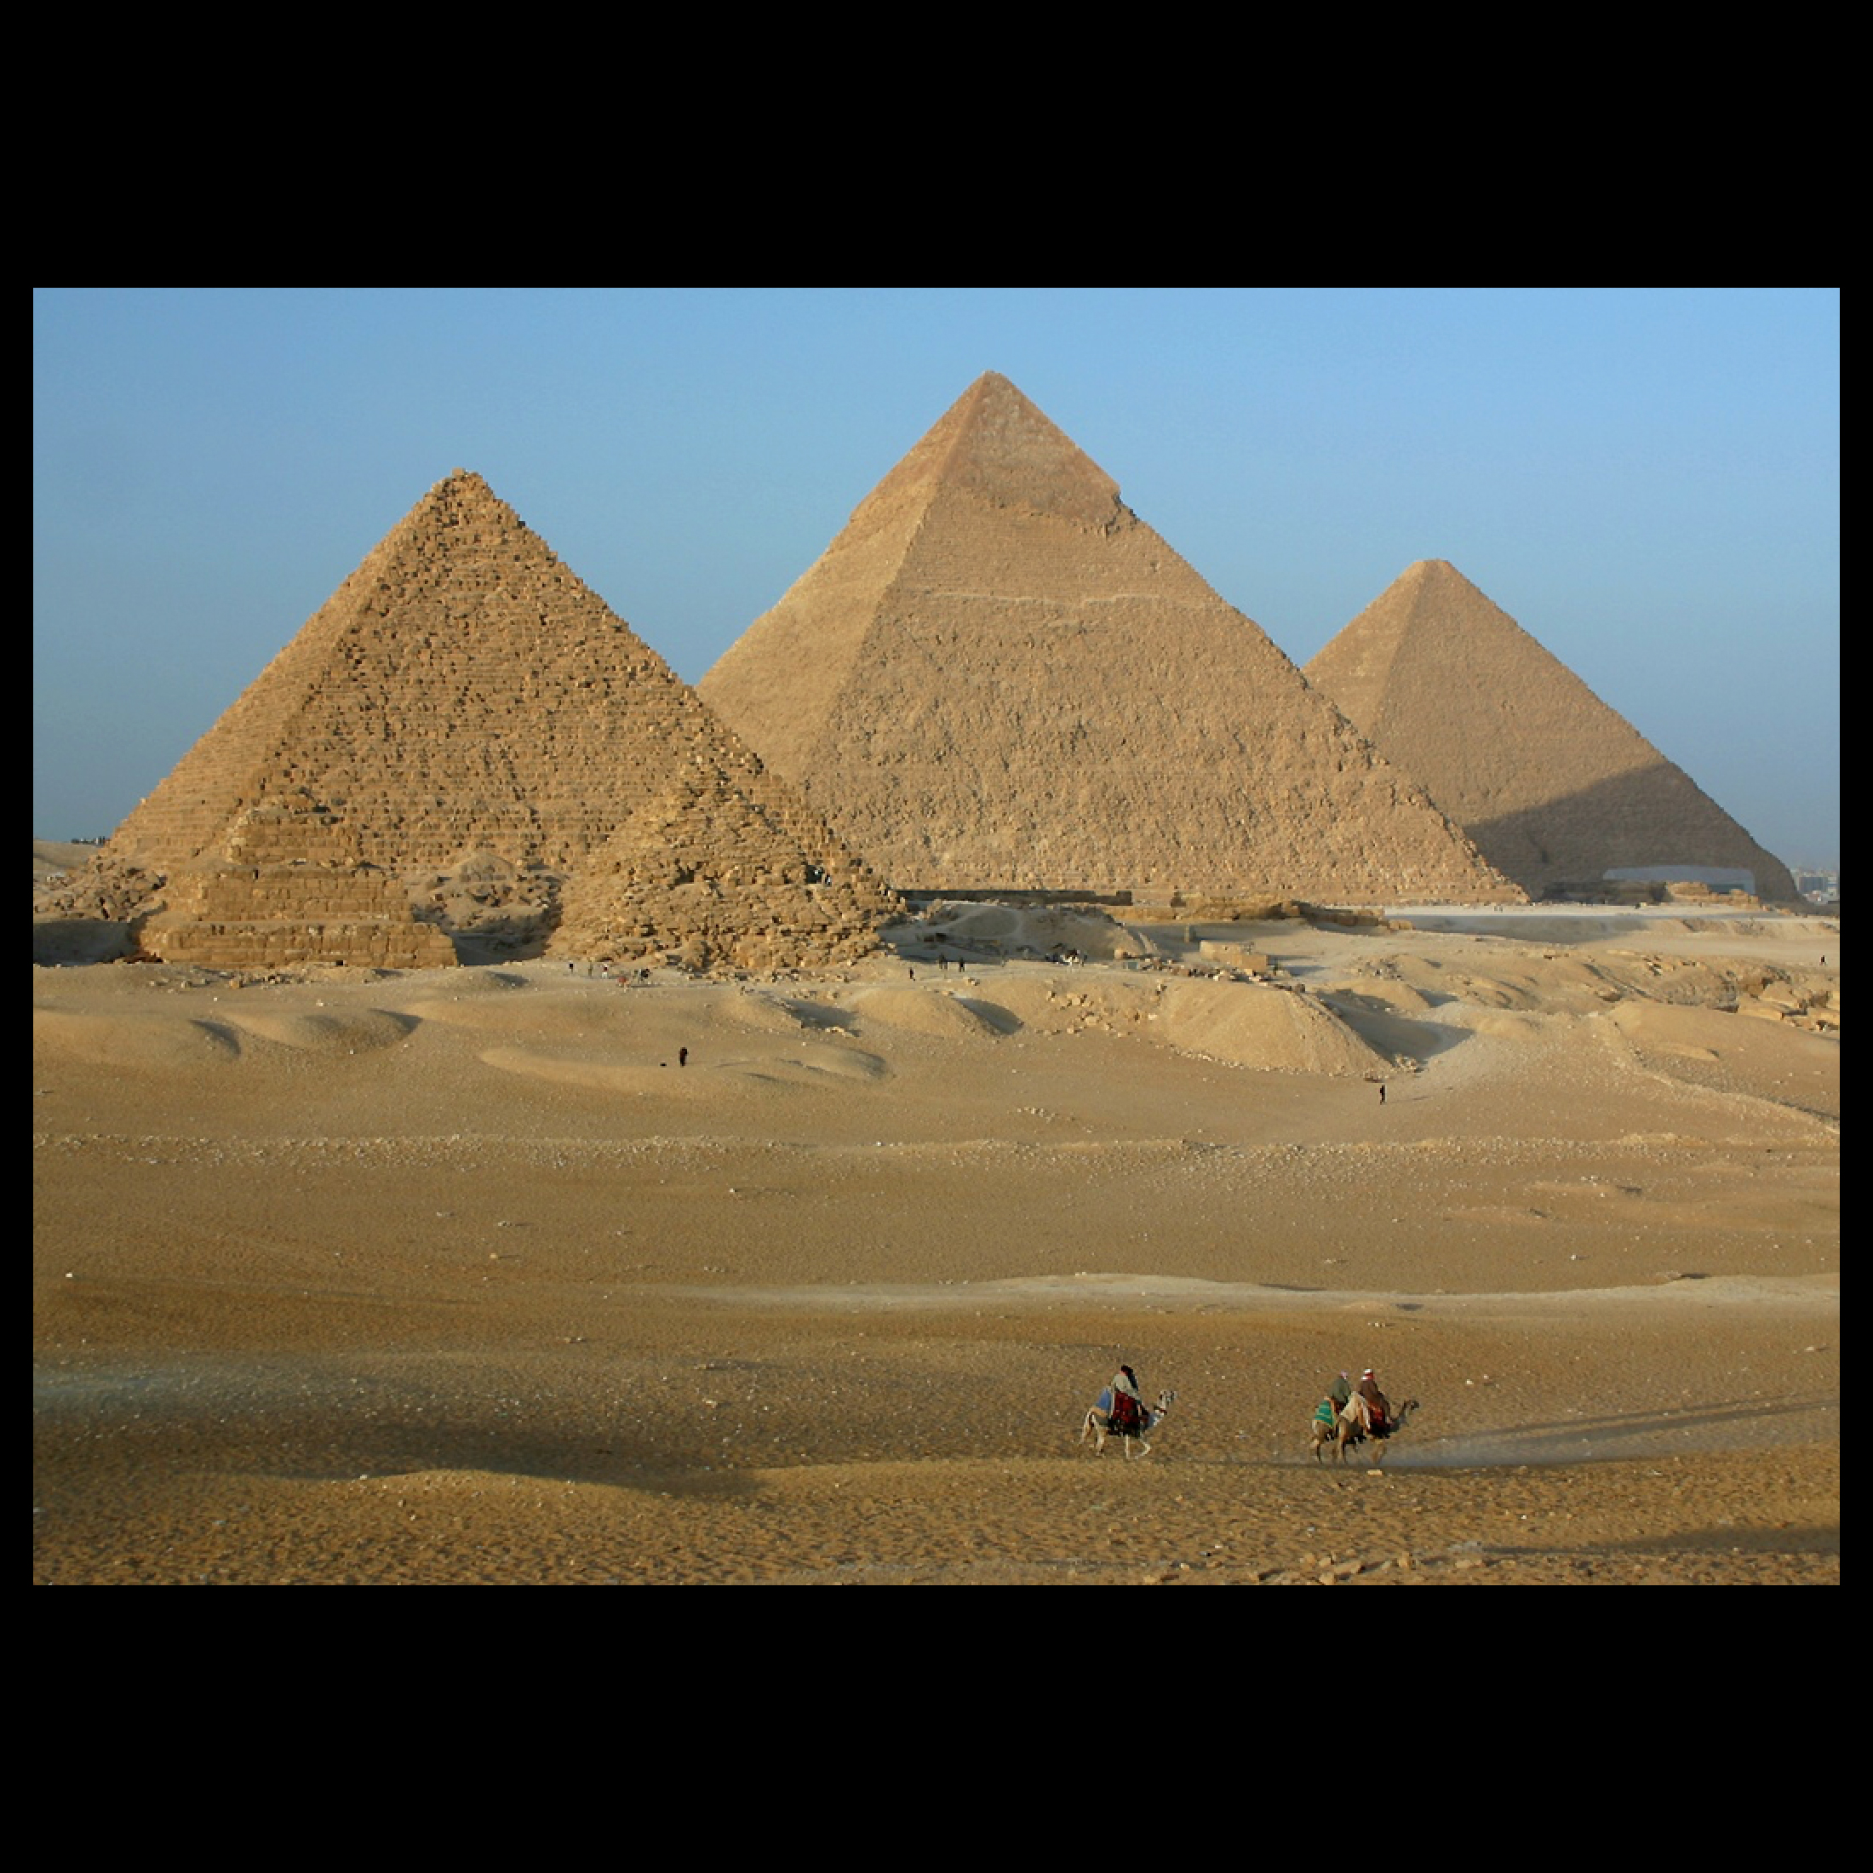
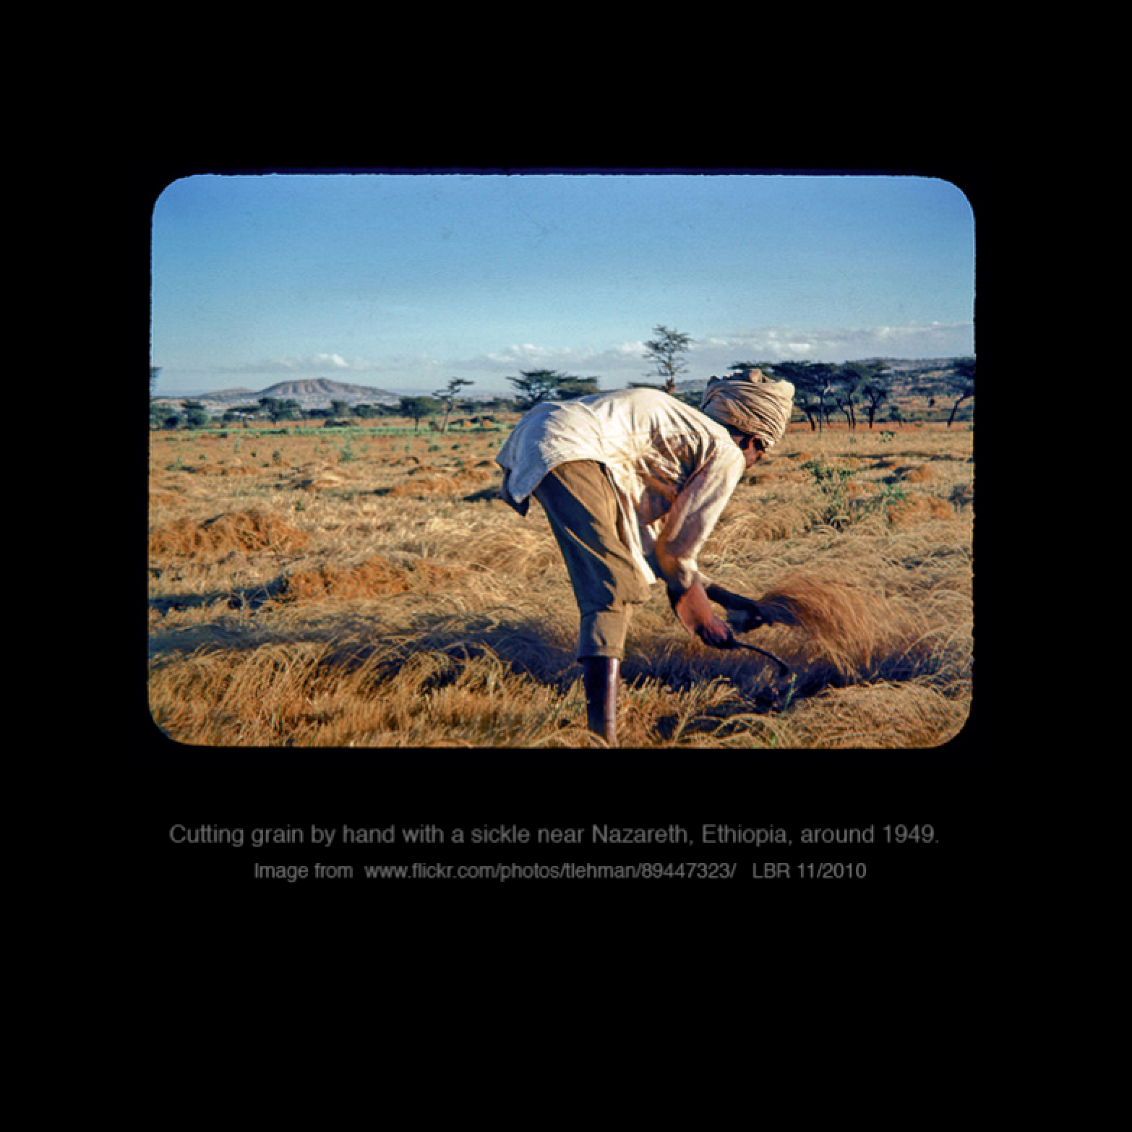
4500 million years = 4.5 billion years
Notes:
2. When we used this illustration to talk about the age of the Earth, the point was that 4 and 1/2 billion years is a VERY long time.

Slide 3
4500 million years = 4.5 billion years
Time in which Earth’s natural resources
were generated
Notes:
3. For this lecture, the point is Earth’s georesources formed over that very long time of 4 and 1/2 billion years,

Slide 4
4500 million years = 4.5 billion years
Time in which
humans have consumed
those resources
Time in which Earth’s natural resources
were generated
Notes:
4. and the time in which we have used up those resources has been, by comparison, brief.

Slide 5
Lecture 26: Resource issues on a finite Earth
We have in centuries used up much of the
non-renewable resources of a very old planet.
Notes:
5. That is, in fact, the principle conclusion of this lecture: We have in centuries used up much of the non-renewable resources of a very old planet.

Slide 6
Lecture 26: Resource issues on a finite Earth
We have in centuries used up much of the
non-renewable resources of a very old planet.
Two examples:
Notes:
6. As evidence of that conclusion, I want to demonstrate that we have indeed used up the most readily available forms of two key resources.

Slide 7
Lecture 26: Resource issues on a finite Earth
We have in centuries used up much of the
non-renewable resources of a very old planet.
Two examples:
Petroleum
Notes:
7. The first is one is petroleum, the literal and metaphorical fuel of the global economy for the last 150 years.

Slide 8
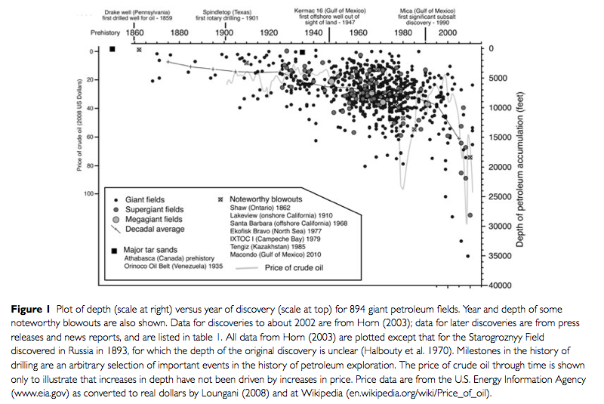
Notes:
8. This is plot from a paper about trends in petroleum discoveries. The caption gives the details, but we can zoom in

Slide 9
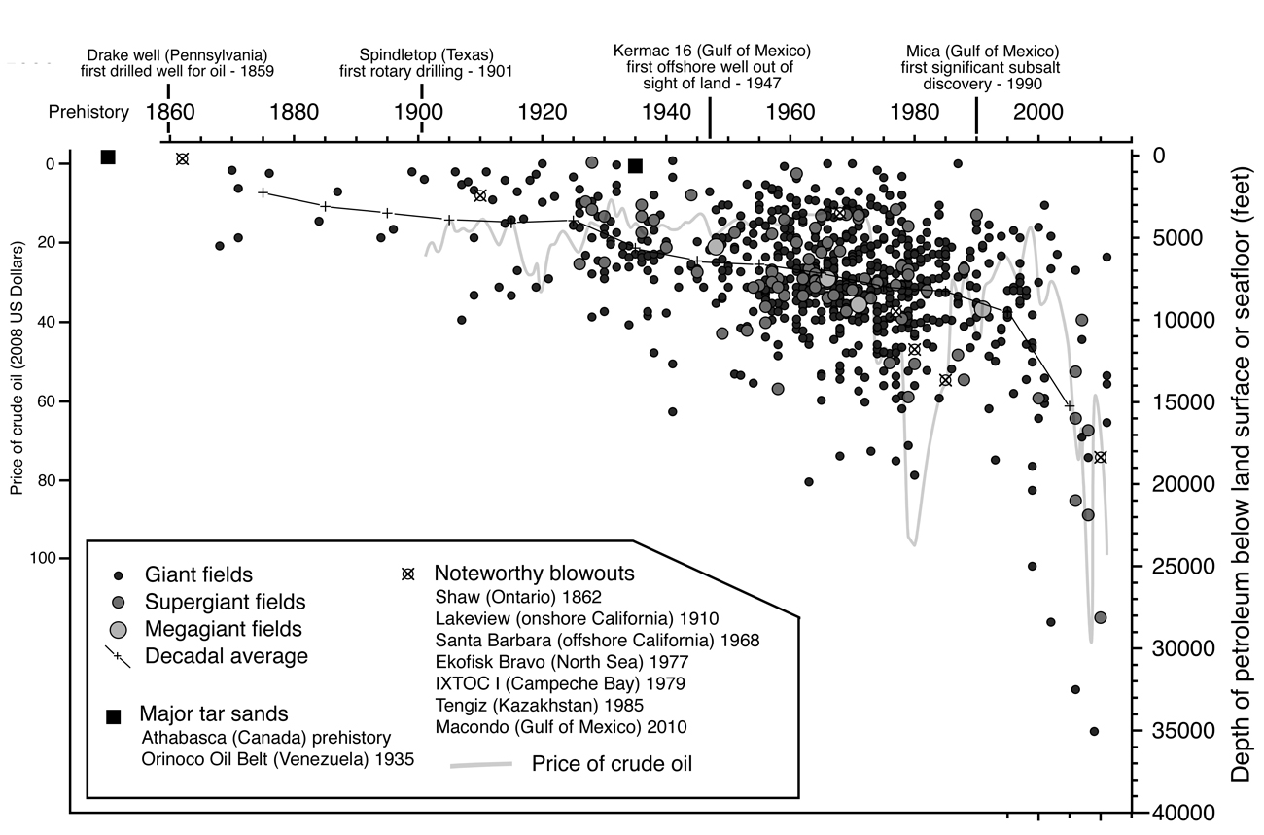
Notes:
9. At the top, the horizontal axis is a time line from the beginning of drilling of oil wells in the 1860s. On the right, the vertical axis is the depth of drilling – down on the graph is down deeper into the Earth. Each of the symbols on the plot represents a giant oilfield, an oilfield with more than 500 million barrels of oil that can be extracted.

Slide 10
Notes:
10. The overall trend shown by this graph has been toward deeper drilling . ..

Slide 11
Notes:
11. and that trend became more extreme in the last twenty years. That trend has been enabled by new technologies, but it also results from drilling into targets that the petroleum industry viewed as too risky in the past. . . . Once you’re done with the lower right, another thing to note is at the upper right of the plot, where there are no symbols

Slide 12
Notes:
12. At the upper right, your see that no giant fields at shallow depths have been discovered in the last 20 or 30 years - and it’s not for lack of looking. We seem to have, by the late 1980s, found all the easy pickings, which is another reason for drilling going so deep in the same time period.

Slide 13
Increasing desperation
Notes:
13. In short, what we’re looking at is a plot of increasing desperation, in which we have developed expensive new deep drilling technologies and taken greater risks in drilling deep to regions of great pressure in the earth. in the effort to find and consume petroleum. Of course, that’s not the only way that we have developed expensive new technologies and taken greater risks to get petroleum in the last decade or so . . .

Slide 14
Fracking – an expensive
technology suggestive
of desperation
Increasing desperation
Notes:
14. We have also resorted to fracking. Fracking is a technology that removes petroleum that oil companies knew in the 1900s was in the ground, but it’s petroleum that could only be removed by methods so extreme that it was far too expensive to extract. In fact, there was general agreement then that we were grateful to not live in a dystopian future when people would be so desperate for petroleum that they would pay for the extreme methods required to get that sort of petroleum out the ground.

Slide 15
Notes:
15. When I say extreme, 1900’s-style drilling was like Part 1 of this sketch: a vertical hole in the ground. Fracking requires Part 2: controlling the drill bit to make a hole that follows a petroleum-bearing layer of rock and then the pumping of fluids into that hole at such great pressures to break that layer apart, pulverizing the earth from the inside. Not surprisingly, that’s very expensive . ..

Slide 16
Notes:
16. This is news report about the cost of fracking to get oil out of shale, an impermeable rock, and in the takeaways at right . . .

Slide 17
Notes:
17. you see that extracting oil by fracking costs about twice as much as the conventional drilling that was typical of the 1900s.

Slide 18
Fracking – an expensive
technology suggestive
of desperation
Increasing desperation
Deeper drilling – an
expensive technology
suggestive of desperation
Notes:
18. My point is fracking combines with deep drilling to indicate greater desperation to exploit petroleum. You can see that too . . .

Slide 19
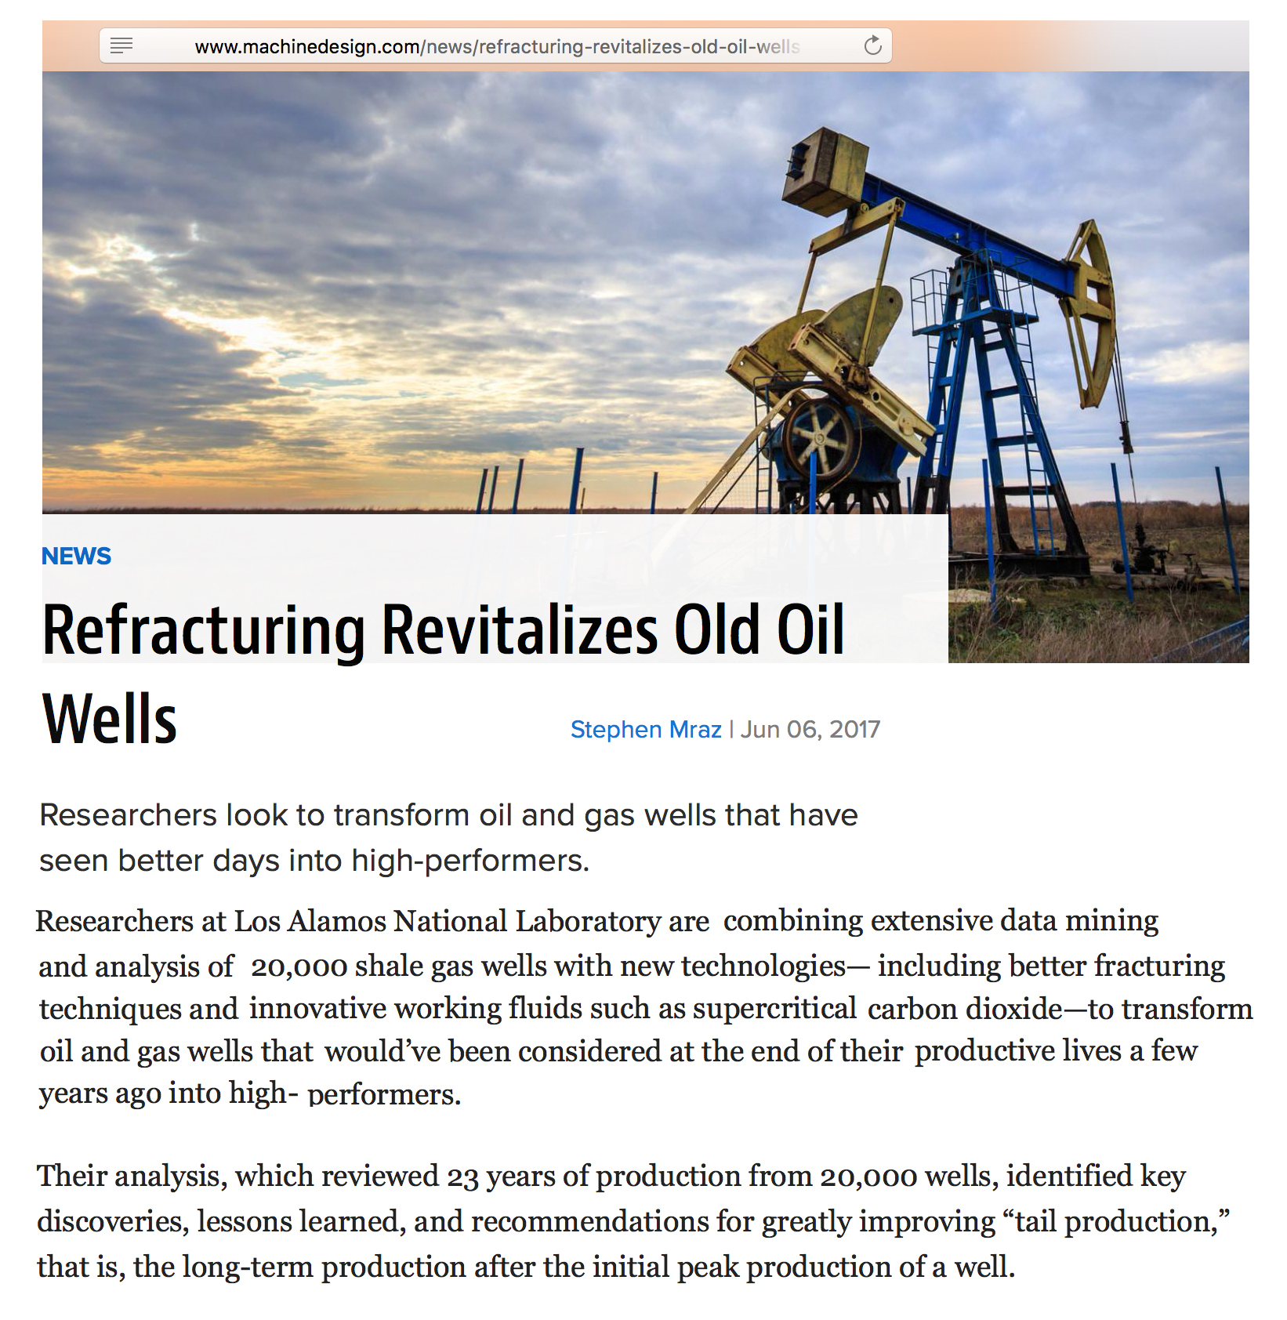
Notes:
19. in that we are now drilling into old oil deposits that were previously exploited to their economic limits and abandoned, but their residues are now economically significant – kind of like getting hungry and pulling yesterday’s empty peanut-butter jar out of the garbage to see if you can get a little more peanut butter to feed yourself today, which is a sign of desperation.

Slide 20
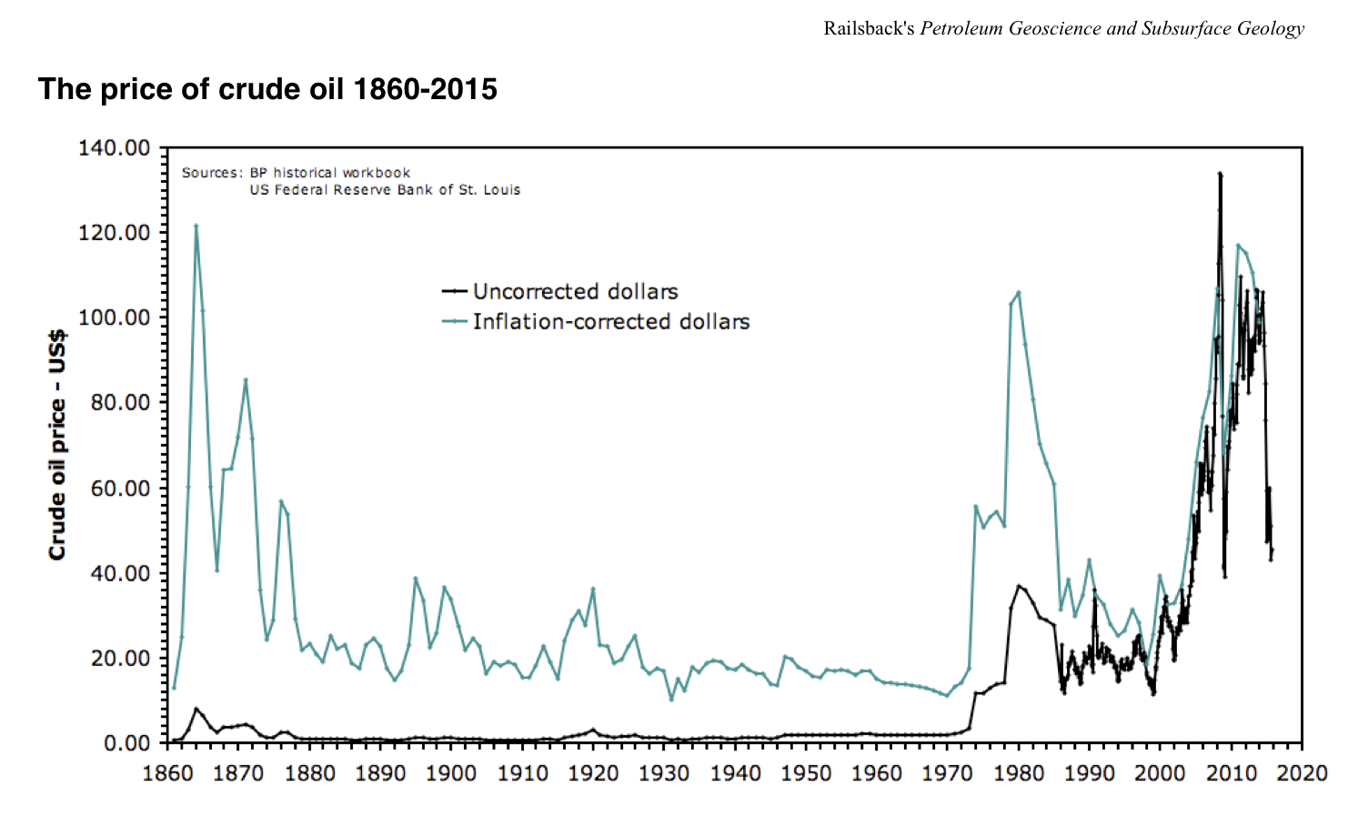
Increasing desperation
Notes:
20. All of that is thinking about the technologies and sources to which we will resort. Another measure of desperation is of course what we will pay for petroleum. This is plot of the price of petroleum over the last 160 years. This plot was made in 2015 . . .

Slide 21
Increasing desperation
Notes:
21. We can get a plot from a constantly updated source to get the last five years at the lower right . . .

Slide 22
Increasing desperation
Notes:
22. and add the last five years in red to the right of the long-term plot.

Slide 23
Increasing desperation
Notes:
23. Of the black and green lines, the green line is best for comparison across time, because it is corrected for inflation. At left, you see high prices early on as the nascent petroleum industry figured out how to be efficient, but from 1880 to 1970 (across the middle of the plot) there is almost a century of steady prices. At the right, the prices have gone up in the last fifty years, with a lot of gyrations with oil embargoes, wars, financial booms, financial busts. If you ignore the spikes and plummets, the overall pattern . .

Slide 24
Increasing desperation
Notes:
24. is upward. Not surprisingly, that upward trend is the time of

Slide 25
Deeper
drilling
Increasing desperation
Notes:
25. Deeper and deeper drilling and

Slide 26
Frack-
ing
Deeper
drilling
Increasing desperation
Notes:
26. fracking and

Slide 27
Re-drilling
Frack-
ing
Deeper
drilling
Increasing desperation
Notes:
27 fracking old used-up wells

Slide 28
Re-drilling
Frack-
ing
Deeper
drilling
Increasing desperation
Increasing desperation,
as Earth’s petroleum
has been used up.
Notes:
28 all of which is part of the pattern of increasing desperation as Earth’s petroleum resources, or at least the more easily exploited parts of them, have been used up.

Slide 29
Lecture 26: Resource issues on a finite Earth
We have in centuries used up much of the
non-renewable resources of a very old planet.
Two examples:
Petroleum
Mineral resources
Notes:
29. Let’s turn to the other (and shorter) half of this presentation, which is about mineral resources, and mostly about metal ores.

Slide 30
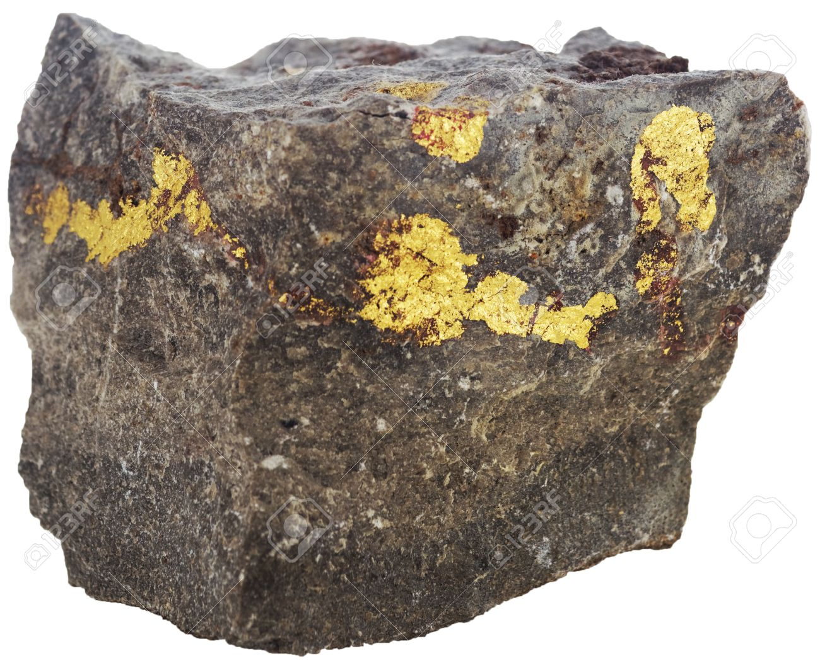
A spectacularly rich (high-grade) gold ore
Notes:
30. This is a spectacular example of a metal ore. Nonetheless, you can see that most of the rock isn’t gold. Instead, it’s economically useless mineral material that will be pulverized in extracting the desired metal. The percent of the rock that is the desired metal is the ore’s grade, and obviously a mining company would prefer to exploit higher-grade, rather than lower-grade ores.

Slide 31
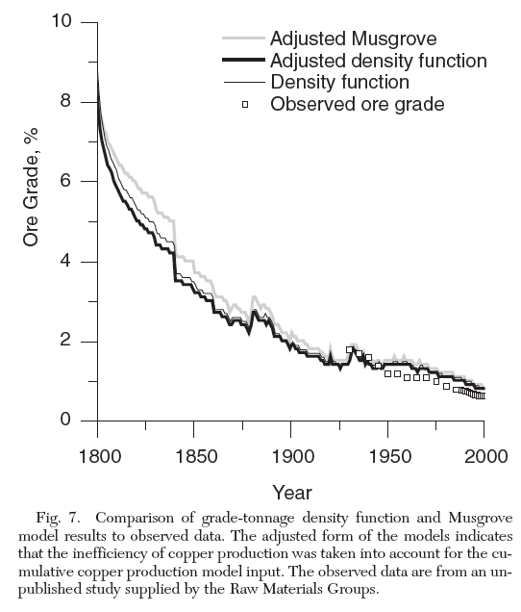
Notes:
31. With that said, we can look at historical trends in the grades of ores mined through time. This is a plot for copper ores showing that, two centuries ago, miners considered ores around 8% copper to be economically meaningful, and everything thing else was just a rock. Through time, the grade that was economically ore rather than rock diminished, because the higher-grade ores had mostly already been mined out.

Slide 32
Increasing desperation
Notes:
32. As a result, this is a graph of increasing desperation, and today we mine ores that would have been ignored as junk rock by the prospectors and mining companies of a few decades ago.
This graph is easy to read because it is showing information about one resource, copper.

Slide 33
Dr. A.M. Diederen, TNO Defence, Security and Safety - Physical Protection & Survivability (Rijswijk, The Netherlands)
for Energy Day at Eindhoven University of Technology September 16, 2010
Notes:
33. This graph, by contrast, is hard to read because it shows information about six metals, and diamonds too. It’s a mess, but the pattern is the same: ores that would have been ignored as junk by the prospectors and mining companies of a few decades ago are now things that we are sufficiently desperate to mine and refine.

Slide 34
Dr. A.M. Diederen, TNO Defence, Security and Safety - Physical Protection & Survivability (Rijswijk, The Netherlands)
for Energy Day at Eindhoven University of Technology September 16, 2010
Notes:
34. This graph doesn’t show grades of ores but, with its bars, show numbers of new discoveries of ores. The blue bars indicate major deposits, and the orange bars indicate spectacular deposits. Both of them show decreasing trends, reflecting that we have already found most if not all of the big deposits. The green line shows that it’s not for lack of effort: the money put into exploration for new deposits has gone up, but the exploration has found less and less.

Slide 35
Re-exploiting a resource discarded
as “used up” decades ago.
Notes:
35. At this point, we can go back to the petroleum industry’s idea of using a new technology, fracking, on old wells previously viewed as have given up all the oil they could.

Slide 36
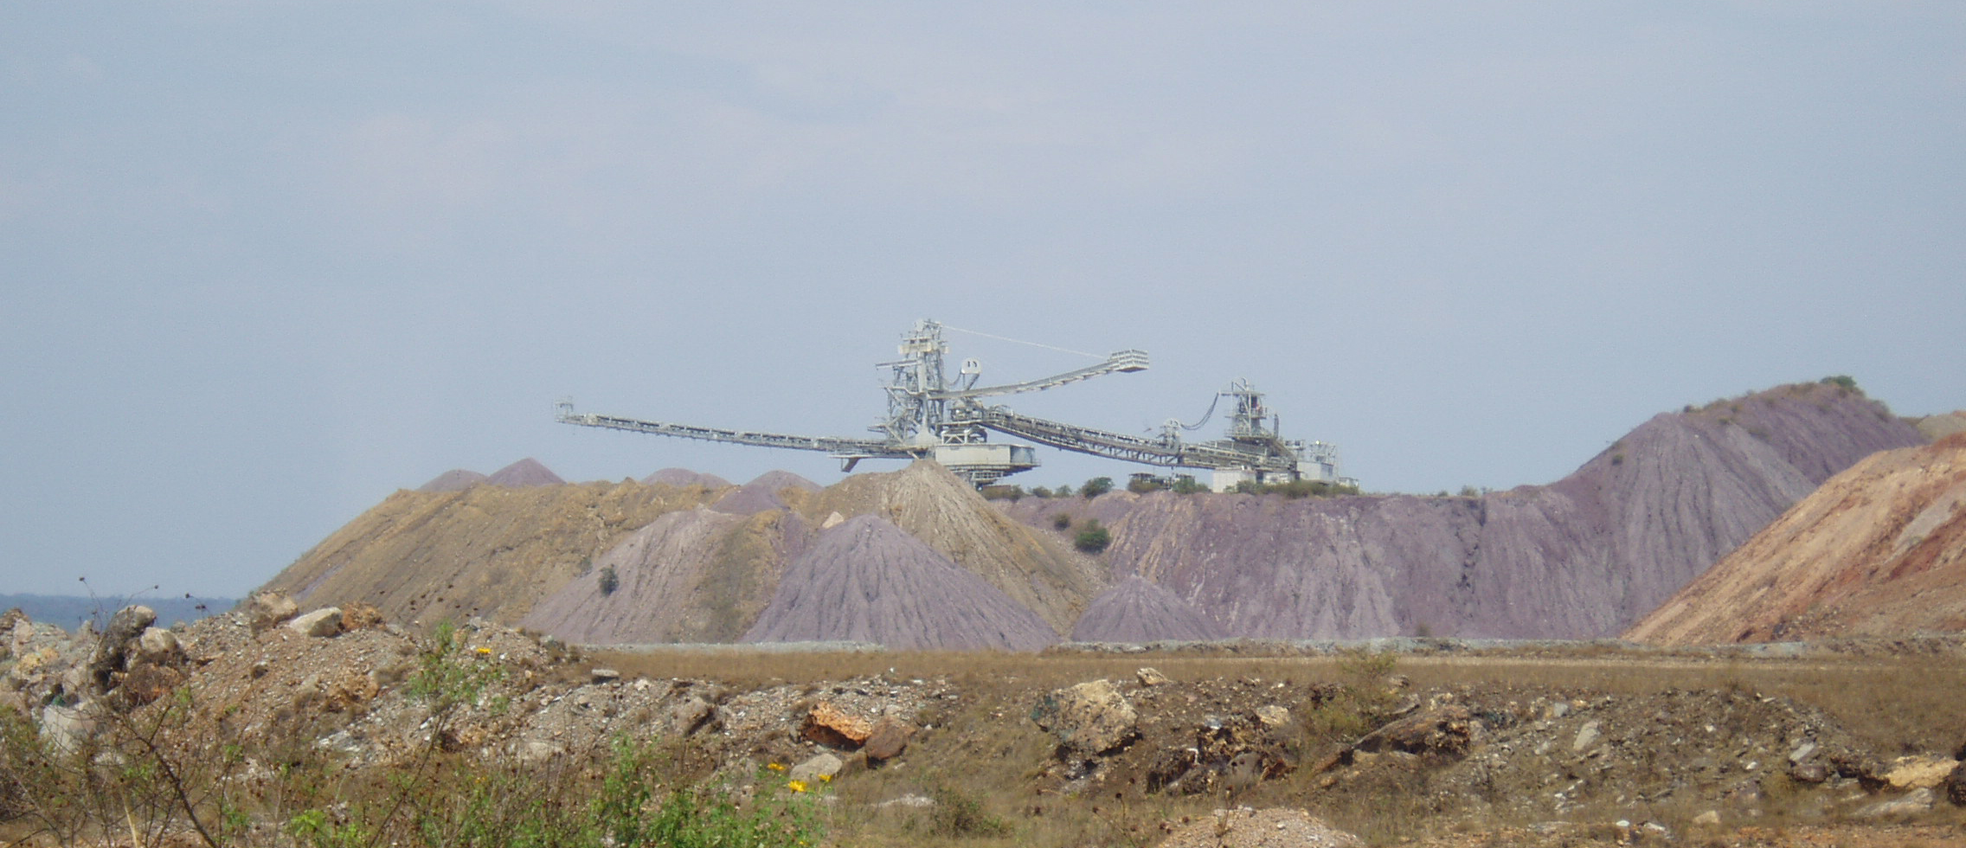
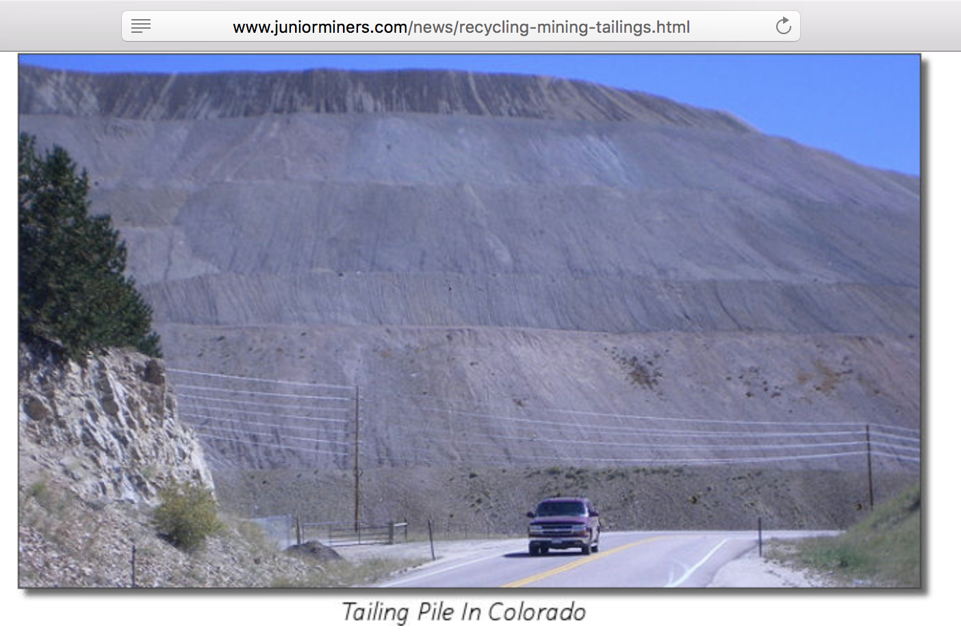
Tailings:
the other 98%
of a 2%-grade ore
Notes:
36. The mining analog is to go back to the tailings piles left from past mining. Those piles can be vast, because in any mining operation most of the pulverized rock ends up in a heap called “tailings”.

Slide 37
Tailings:
the other 98%
of a 2%-grade ore
Tailings of top-grade
modern gold mine:
Notes:
37 In the case of modern gold mines,

Slide 38
Tailings:
the other 98%
of a 2%-grade ore
Tailings of top-grade
modern gold mine:
the other 99.998%
of a 0.002%-grade ore
Notes:
38. the tailings are 99.998% of the rock. Because no refining process is perfect, a little bit of the desired metal remains in the tailings, so today . .

Slide 39
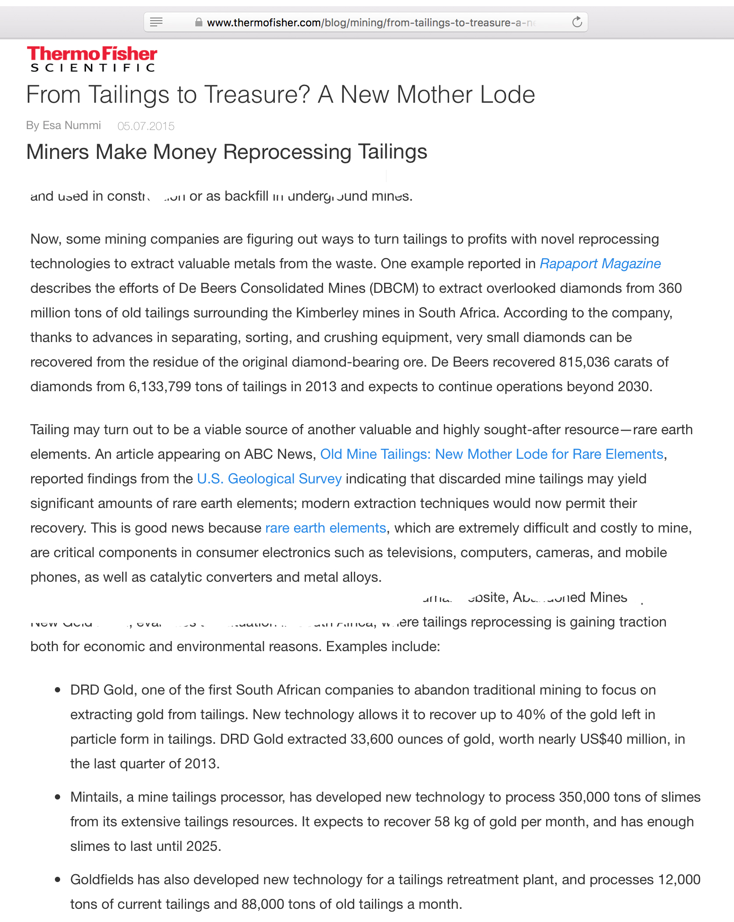
Notes:
39 Mining companies are re-processing their past tailings.

Slide 40
Notes:
40. This is again the strategy of, if you’re desperate for food, you pull yesterday’s empty peanut butter jar out the garbage and try to scrape some more peanut butter from it

Slide 41
Desperation as billions of years of ore
have been mined out in a few decades
Notes:
41. Again, it’s an indicator of desperation at having used up Earth’s resources, and it gets us back to the point of this lecture

Slide 42
Lecture 26: Resource issues on a finite Earth
We have in centuries used up much of the
non-renewable resources of a very old planet.
Two examples:
Petroleum
Mineral resources
Notes:
42. We have IN CENTURIES used up much of the resources of a billions-of-years-old planet.

Slide 43
Lecture 26: Resource issues on a finite Earth
We have in centuries used up much of the
non-renewable resources of a very old planet.
Two examples:
Petroleum
Mineral resources
Solutions:
Notes:
43. The question becomes, what do you do about it?

Slide 44
Lecture 26: Resource issues on a finite Earth
We have in centuries used up much of the
non-renewable resources of a very old planet.
Two examples:
Petroleum
Mineral resources
Solutions:
Waiting for the planet to generate more
Notes:
44. One WRONG answer is to hope that the planet will regenerate the resources that it took millions if not billions of year to generate.

Slide 45
4500 million years = 4.5 billion years
Time in which
humans have consumed
those resources
Time in which Earth’s natural resources
were generated
Notes:
45. .The age of the Earth compared to the time in which we have depleted its resources makes THAT clear.

Slide 46
Lecture 26: Resource issues on a finite Earth
We have in centuries used up much of the
non-renewable resources of a very old planet.
Two examples:
Petroleum
Mineral resources
Solutions:
Waiting for the planet to generate more
Notes:
46. It just won’t work.

Slide 47
Lecture 26: Resource issues on a finite Earth
We have in centuries used up much of the
non-renewable resources of a very old planet.
Two examples:
Petroleum
Mineral resources
Solutions:
Less and more efficient use
Notes:
47. One solution is to find ways that use less, which means using resources more efficiently. However, even that obviously can’t go on too long on a finite planet.

Slide 48
Lecture 26: Resource issues on a finite Earth
We have in centuries used up much of the
non-renewable resources of a very old planet.
Two examples:
Petroleum
Mineral resources
Solutions:
Less and more efficient use
For energy: alternate sources
Notes:
48. For energy, the answer has to lie in alternate energy sources . . . and the good news is that most of them don’t emit greenhouse gases, another of the great problems that we’ve talked about - so in fact, there’s good news there.

Slide 49
Lecture 26: Resource issues on a finite Earth
We have in centuries used up much of the
non-renewable resources of a very old planet.
Two examples:
Petroleum
Mineral resources
Solutions:
Less and more efficient use
For energy: alternate sources
For metals: recycling
Notes:
49. For metals, the obvious answer lies in recycling.

Slide 50
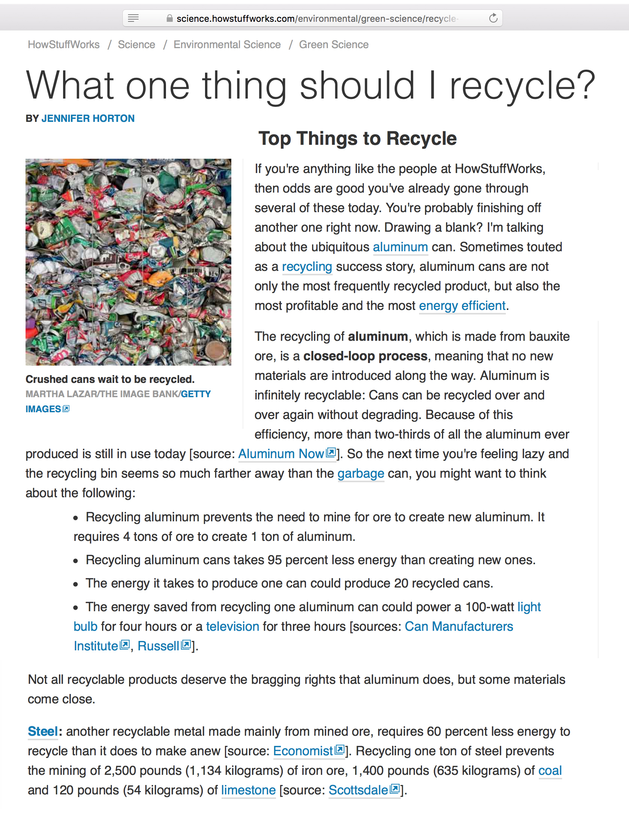
Notes:
50. I’ve always thought it was criminal to let metal go into landfills rather than be recycled, and these folks seem to agree. We do some recycling in this country . . .

Slide 51
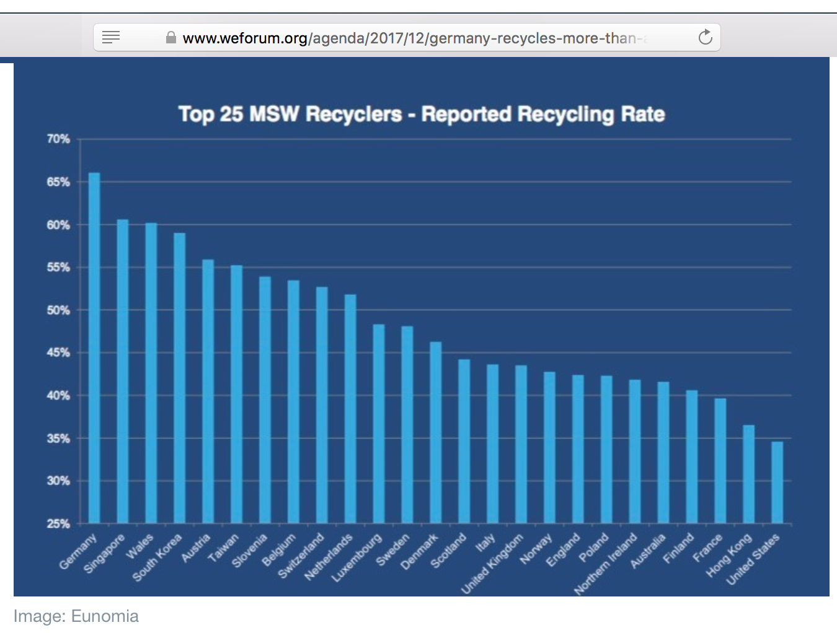
Notes:
51. But comparison with the rest of the developed world says that we could do a lot better:

Slide 52
You are here.
Notes:
52. We’re not doing even half as much recycling as some countries.

Slide 53
Lecture 26: Resource issues on a finite Earth
We have in centuries used up much of the
non-renewable resources of a very old planet.
Two examples:
Petroleum
Mineral resources
Solutions:
Less and more efficient use
For energy: alternate sources
For metals: recycling
Notes:
53. So . . if the message of this message of this lectured seemed depressing . . .

Slide 54
Lecture 26: Resource issues on a finite Earth
We have in centuries used up much of the
non-renewable resources of a very old planet.
Two examples:
Petroleum
Mineral resources
Solutions:
Less and more efficient use
For energy: alternate sources
For metals: recycling
Notes:
54 There are solutions! We are a nation that has always prided itself on its can-do attitude . ..

Slide 55
Lecture 26: Resource issues on a finite Earth
We have in centuries used up much of the
non-renewable resources of a very old planet.
Two examples:
Petroleum
Mineral resources
Solutions:
Less and more efficient use
For energy: alternate sources
For metals: recycling
We can do it.
Notes:
55. That’s perhaps best exemplified in how this nation went from its isolationist “oh, who-needs-an-army?” attitude in 1941 to winning World War II in both Europe and the Pacific by 1945.
We did THAT by putting our minds and hard work into it,

Slide 56
Lecture 26: Resource issues on a finite Earth
We have in centuries used up much of the
non-renewable resources of a very old planet.
Two examples:
Petroleum
Mineral resources
Solutions:
Less and more efficient use
For energy: alternate sources
For metals: recycling
We can do it.
Notes:
56. and WE CAN DO THIS.

